Slide 1

DESIGN PATTERNS
Design patterns are solutions to common software design problems that occur repeatedly in real-world application development.

Slide 2
WHAT IS IT
WYH USE
HOW TO USE
TYPES
EXAMPLES

Slide 3




What are design patterns and why are they used?
Design patterns are solutions to common software design problems that come up again and again in real-world application development. They are not ready-made code snippets that you can copy and paste into your project, but general guidelines or templates that you can customize and adapt to your specific situation.

Slide 4
Design patterns help you to
Improve the quality and maintainability of your code by following proven principles and best practices.
Solve complex design problems with simple and elegant solutions that have been tested and refined by experienced developers.
Communicate more effectively with other developers by using a common terminology and vocabulary for describing design issues and solutions.
Learn from the wisdom and expertise of others who have faced similar challenges and solved them successfully.

Slide 5

What is Gang of Four (GOF)?
In 1994, four authors Erich Gamma, Richard Helm, Ralph Johnson and John Vlissides published a book titled Design Patterns - Elements of Reusable Object-Oriented Software which initiated the concept of Design Pattern in Software development.
These authors are collectively known as Gang of Four (GOF). According to these authors design patterns are primarily based on the following principles of object orientated design.
Program to an interface not an implementation
Favor object composition over inheritance

Slide 6

Why should I learn patterns?
The truth is that you might manage to work as a programmer for many years without knowing about a single pattern. A lot of people do just that. Even in that case, though, you might be implementing some patterns without even knowing it. So why would you spend time learning them?

Slide 7

Why should I learn patterns?
Design patterns are a toolkit of tried and tested solutions to common problems in software design. Even if you never encounter these problems, knowing patterns is still useful because it teaches you how to solve all sorts of problems using principles of object-oriented design.
Design patterns define a common language that you and your teammates can use to communicate more efficiently. You can say, “Oh, just use a Singleton for that,” and everyone will understand the idea behind your suggestion. No need to explain what a singleton is if you know the pattern and its name.

Slide 8
Why Use Design Patterns?
Increased code readability: Design patterns can help to make code more readable by providing a common vocabulary and set of conventions for solving problems. This can make it easier for developers to understand and maintain code that uses design patterns.
Improved code maintainability: Design patterns can help to improve code maintainability by making it easier to make changes to code without breaking other parts of the system. This is because design patterns provide a well-defined way of solving problems, which makes it easier to understand how changes to one part of the system will affect other parts of the system.
Increased code reuse: Design patterns can help to increase code reuse by providing a way to solve problems that have been solved before. This can save time and effort by eliminating the need to reinvent the wheel every time a new problem is encountered.
Improved software quality: Design patterns can help to improve software quality by making it easier to create well-designed and well-functioning software. This is because design patterns provide a set of best practices for solving problems, which can help to ensure that software is designed and implemented in a way that is efficient, effective, and reliable.

Slide 9

How to Use Design Patterns?
Design patterns are not one-size-fits-all solutions that you can apply blindly to any situation. They are tools that you need to use wisely and appropriately, depending on the context and the problem at hand. Here are some tips on how to use design patterns effectively.

Slide 10

How to Use Design Patterns?
Understand the problem and the context. Before choosing a design pattern, you need to analyze the problem you are trying to solve and the constraints and requirements of your system. You also need to consider the trade-offs and consequences of using a certain pattern over another.

Slide 11

How to Use Design Patterns?
Know the available patterns and their categories. There are many design patterns out there, and they can be classified by their intent and purpose. For example, some patterns deal with creating objects (creational patterns), some deal with structuring objects (structural patterns), and some deal with coordinating objects (behavioral patterns). You should familiarize yourself with the most common and useful patterns in each category and understand their pros and cons.

Slide 12

How to Use Design Patterns?
Choose the most suitable pattern for your problem. Once you have a clear understanding of the problem and the context, you can select the pattern that best fits your needs. You should compare different patterns and evaluate how well they solve your problem, how easy they are to implement, how readable they are, how reusable they are, and how well they fit with your existing code.

Slide 13

How to Use Design Patterns?
Implement the pattern according to your specific situation. After choosing a pattern, you need to adapt it to your specific scenario. You should follow the general structure and guidelines of the pattern, but also customize it according to your own preferences and conventions. You should also document your code well and explain why you used a certain pattern and how it works.

Slide 14
Best Practices
Common platform for developers
Design patterns have been evolved over a long period of time and they provide best solutions to certain problems faced during software development. Learning these patterns helps unexperienced developers to learn software design in an easy and faster way.
Design patterns provide a standard terminology and are specific to particular scenario. For example, a singleton design pattern signifies use of single object so all developers familiar with single design pattern will make use of single object and they can tell each other that program is following a singleton pattern.

Slide 15
Classıfıcatıon of patterns
Design patterns differ by their complexity, level of detail and scale of applicability to the entire system being designed. I like the analogy to road construction: you can make an intersection safer by either installing some traffic lights or building an entire multi-level interchange with underground passages for pedestrians.
The most basic and low-level patterns are often called idioms. They usually apply only to a single programming language.
The most universal and high-level patterns are architectural patterns. Developers can implement these patterns in virtually any language. Unlike other patterns, they can be used to design the architecture of an entire application.

Slide 16
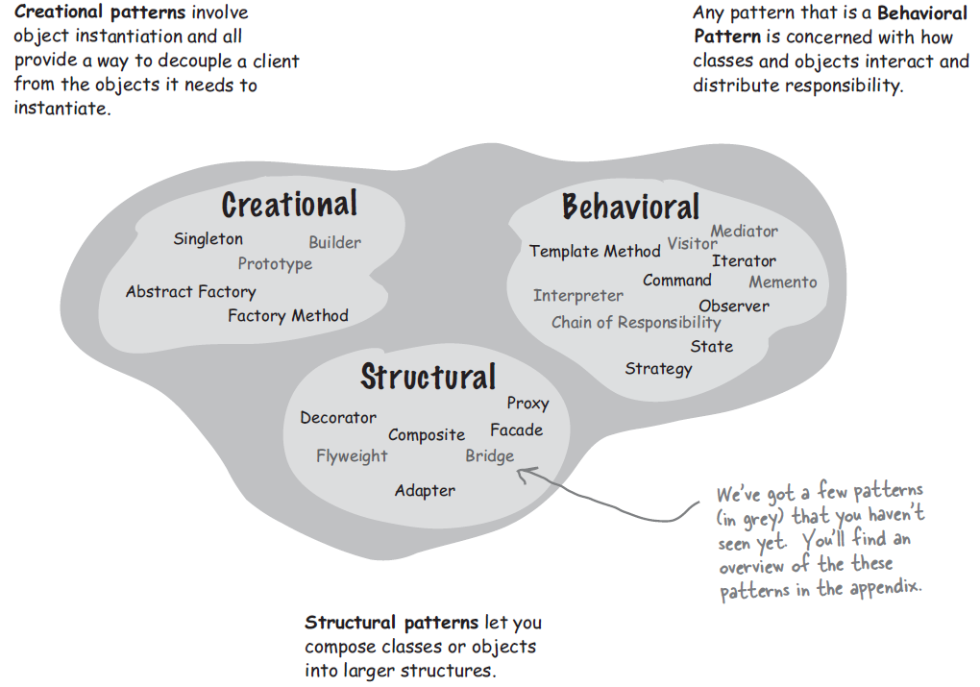
gof design patterns
All patterns can be categorized by their intent, or purpose. This book covers three main groups of patterns(GoF):

Slide 17
Catalog of Design Patterns
Creational patterns: Creational patterns are used to create objects. Some common creational patterns include the Singleton pattern, the Factory pattern, and the Prototype pattern.
Structural patterns: Structural patterns are used to arrange objects into a structure. Some common structural patterns include the Adapter pattern, the Bridge pattern, and the Composite pattern.
Behavioral patterns: Behavioral patterns are used to define how objects interact with each other. Some common behavioral patterns include the Observer pattern, the Strategy pattern, and the State pattern.

Slide 18
Catalog of Design Patterns
Behavioral patterns
Creational patterns
Creational patterns

Slide 19
Design Patterns for Game Development
In this part, I will introduce some of the most common and useful design patterns for game development in C#, and show you how to implement them using Unity. These patterns are:
Singleton
Object Pool
Command
State
Observer

Slide 20

Singleton pattern
The singleton pattern ensures that only one instance of a class exists in the system. It provides a global access point to that instance. This pattern is useful when you need to control access to a shared resource or coordinate actions across the system.
The Singleton pattern disables all other means of creating objects of a class except for the special creation method. This method either creates a new object or returns an existing one if it has already been created.
The singleton pattern is used to ensure that there is only one instance of a class in the game world. For example, you could use the singleton pattern to create a single instance of a game world manager.

Slide 21

SINGLETON pattern – Real world examples
Imagine a coffee shop with only one coffee machine. No matter how many customers come in, there is only one machine that can be used to make coffee. The coffee machine is a singleton because there is only one instance of it.

Slide 22
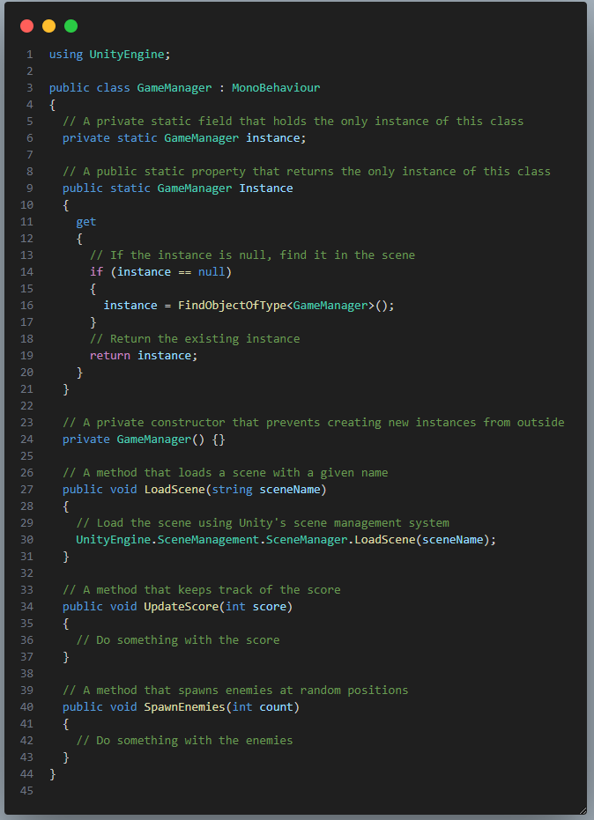
Singleton pattern
Use the Singleton pattern when a class in your program should have just a single instance available to all clients.
For example, in a game, you may have a GameManager class that handles the game logic, such as loading scenes, keeping score, spawning enemies, etc. You want to make sure that there is only one GameManager object in the game, and that you can access it from anywhere.
To implement the singleton pattern in C#, you can use a static field to store the instance of the class, and a static property to access it. You can also use a private constructor to prevent creating new instances from outside.

Slide 23
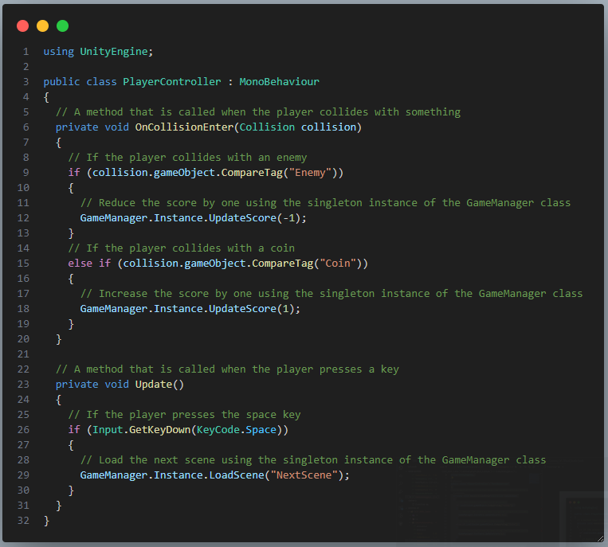

Slide 24
sıngleton pattern - Pros and Cons
You can be sure that a class has only a single instance.
You gain a global access point to that instance.
The singleton object is initialized only when it’s requested for the first time.
Violates the Single Responsibility Principle. The pattern solves two problems at the time.
The Singleton pattern can mask bad design, for instance, when the components of the program know too much about each other.
The pattern requires special treatment in a multithreaded environment so that multiple threads won’t create a singleton object several times.
It may be difficult to unit test the client code of the Singleton because many test frameworks rely on inheritance when producing mock objects. Since the constructor of the singleton class is private and overriding static methods is impossible in most languages, you will need to think of a creative way to mock the singleton. Or just don’t write the tests. Or don’t use the Singleton pattern.

Slide 25

Object Pool pattern
The object pool pattern creates a pool of reusable objects that can be initialized and destroyed on demand. It avoids the overhead of creating and destroying objects frequently. This pattern is useful when you need to optimize performance and memory usage for objects that are used often and briefly.

Slide 26

Object Pool pattern – Real world examples
Imagine you are a manager of a company that has a fleet of cars. You want to make sure that your cars are always available when your employees need them, but you also don't want to have too many cars sitting idle. The object pool pattern can help you achieve this goal. You can create a pool of cars that are available to your employees. When an employee needs a car, they can check out a car from the pool. When the employee is finished with the car, they can return it to the pool. This way, you can ensure that your employees always have a car available when they need it, but you also don't have to pay for more cars than you need.

Slide 27
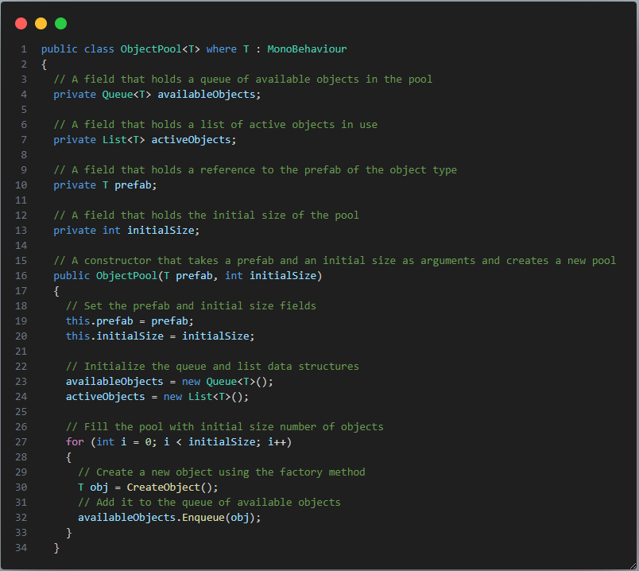
Object Pool pattern
To implement the object pool pattern in C#, you can use a generic class that can store any type of object. You can use a queue data structure to store the available objects in the pool, and a list data structure to store the active objects in use. You can also use a factory method to create new objects for the pool.

Slide 28
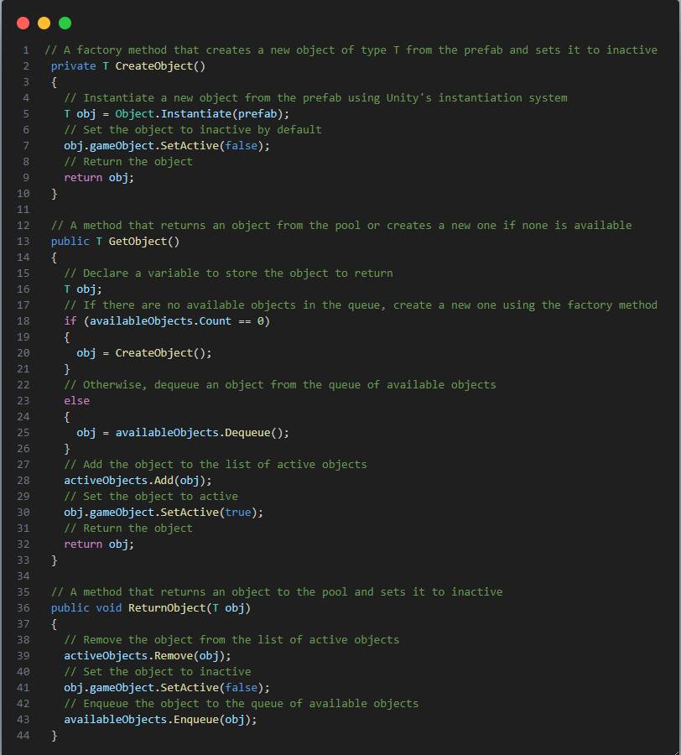

Slide 29
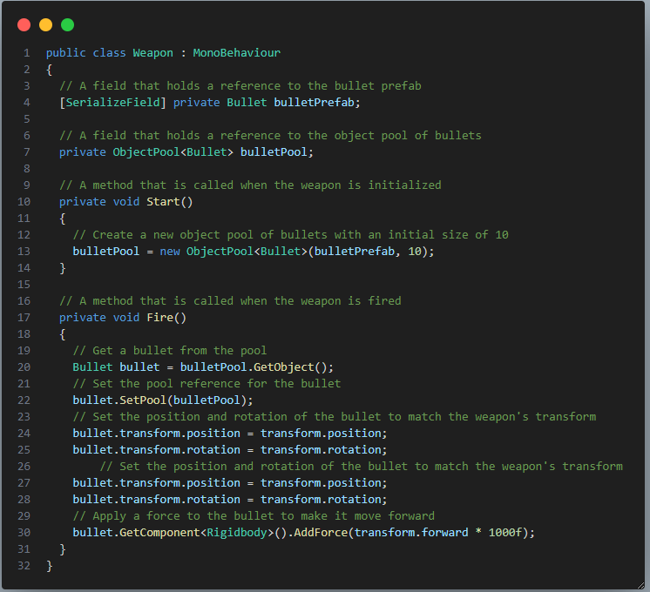
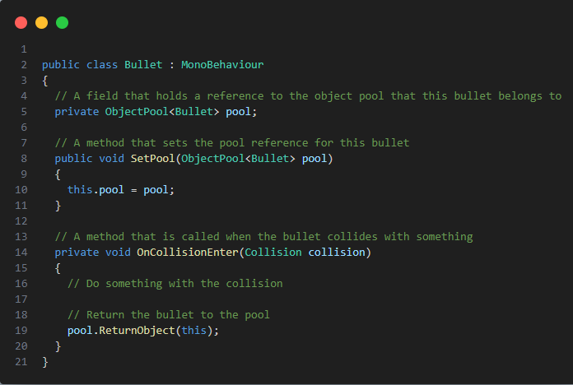
For example, in a game, you may have a Bullet class that represents a bullet fired by a weapon. You want to avoid creating and destroying bullet objects every time you fire or hit something, as this can cause performance issues and memory fragmentation. Instead, you can use an object pool to store a fixed number of bullet objects and reuse them as needed.

Slide 30
Object Pool pattern - Pros and Cons
Reduced memory usage: The object pool pattern can help to reduce memory usage by reusing objects that would otherwise be garbage collected.
Improved performance: The object pool pattern can improve performance by reducing the time it takes to create new objects.
Increased scalability: The object pool pattern can help to increase scalability by making it easier to add new objects to the pool as needed.
Increased complexity: The object pool pattern can add complexity to your code.
Potential for resource leaks: If objects are not returned to the pool properly, they can leak resources.
Not suitable for all situations: The object pool pattern is not suitable for all situations. It is best used when objects are expensive to create and when they are used infrequently.

Slide 31
COMMAND pattern
The command pattern is a behavioral design pattern that encapsulates a request as an object, thereby encapsulating all information about the request. This information includes the receiver of the request, the action to be performed, and the arguments to the action.
The command pattern can be used to decouple the object that requests an action from the object that performs the action. This allows you to add new commands to your game without having to modify the objects that send the commands.
The command pattern can be implemented in a variety of ways. One common way to implement the command pattern is to use an abstract class or interface that defines the methods for executing the command and getting the receiver and arguments. Concrete classes or implementations of the interface can then be used to represent specific commands.

Slide 32
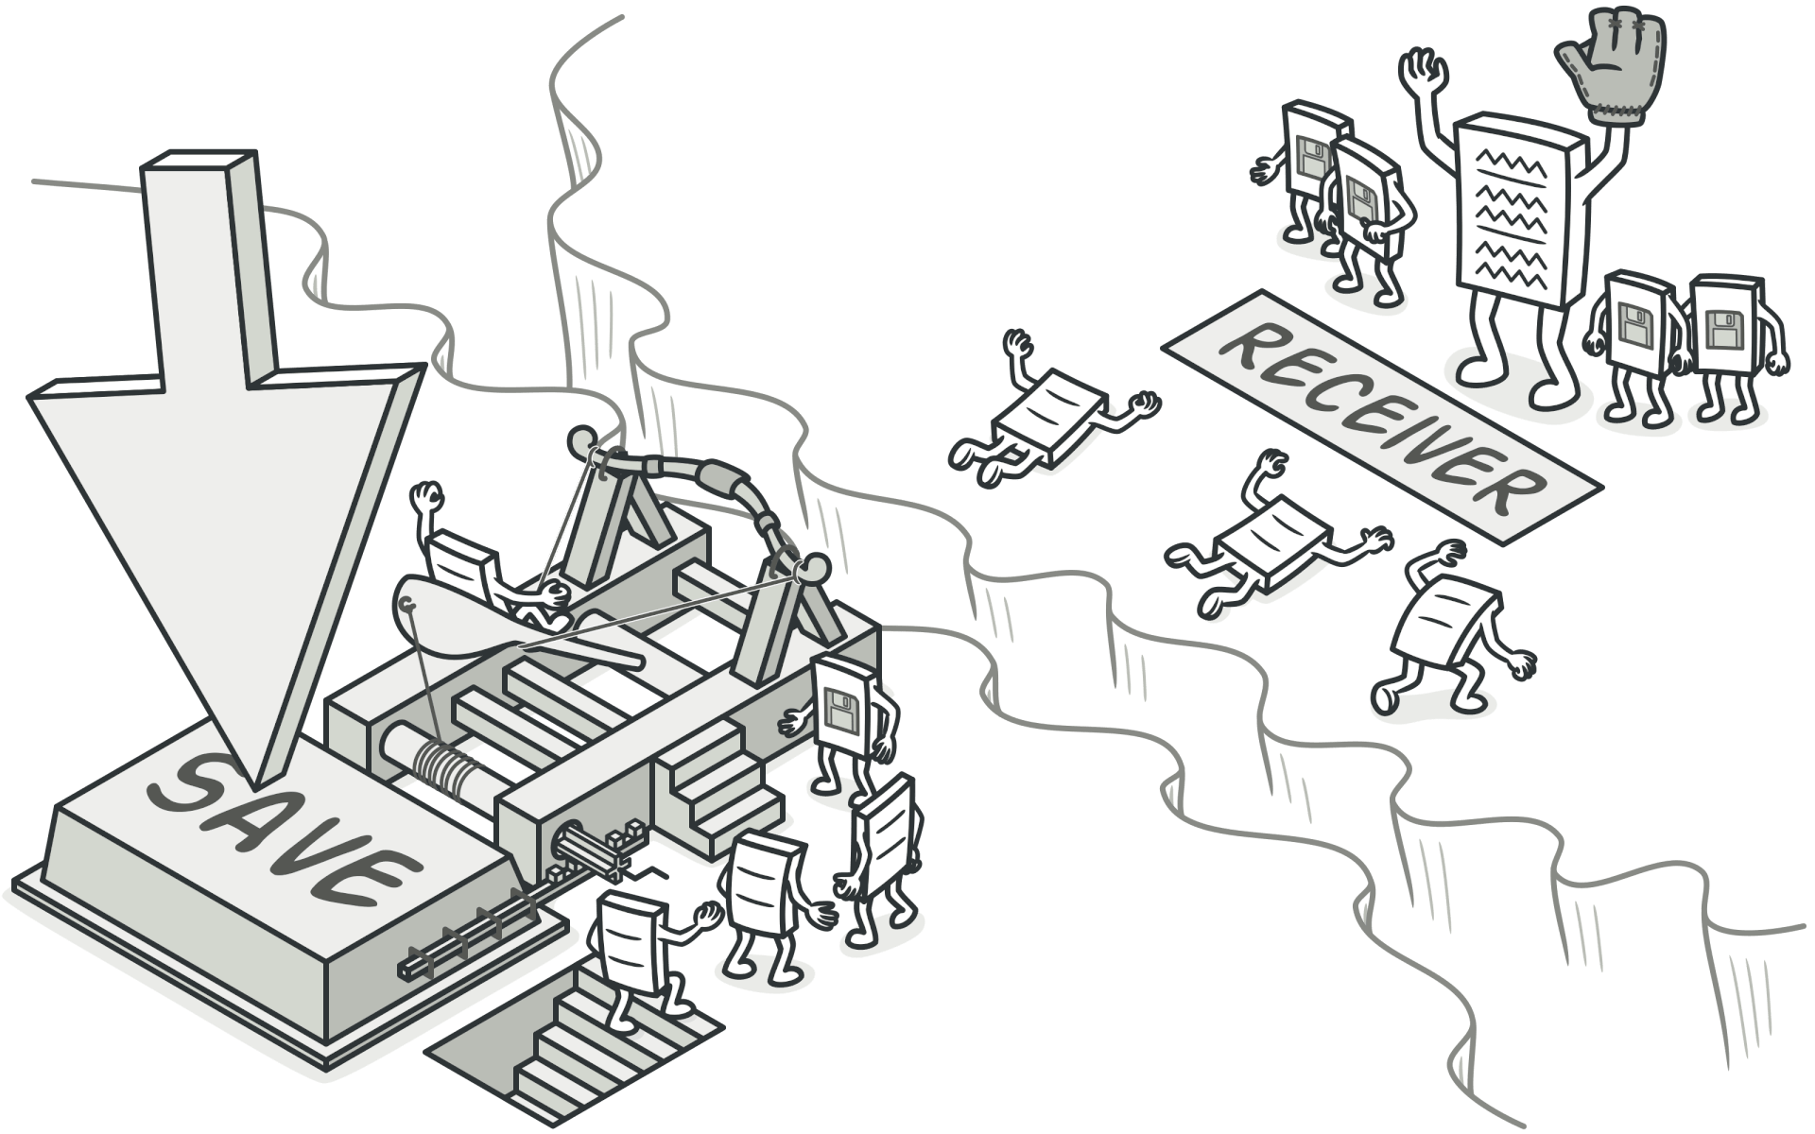
COMMAND pattern
The command pattern involves four terms:
Command
Receiver
Invoker
Client

Slide 33
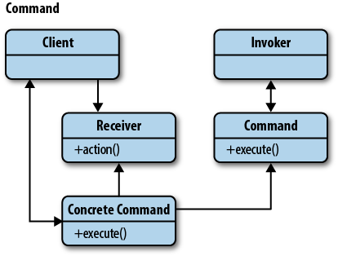
COMMAND pattern
A command object knows about receiver and invokes a method of the receiver. Values for parameters of the receiver method are stored in the command.
The receiver object to execute these methods is also stored in the command object by aggregation. The receiver then does the work when the execute() method in command is called.
An invoker object knows how to execute a command, and optionally does bookkeeping about the command execution. The invoker does not know anything about a concrete command, it knows only about the command interface. Invoker object(s), command objects and receiver objects are held by a client object, the client decides which receiver objects it assigns to the command objects, and which commands it assigns to the invoker.
The client decides which commands to execute at which points. To execute a command, it passes the command object to the invoker object.

Slide 34
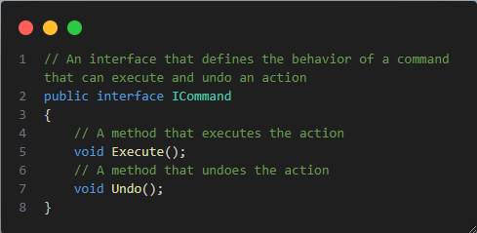
COMMAND pattern
To implement the command pattern in C#, you can use an interface that defines the behavior of a command that can execute and undo an action. You can then create concrete classes that implement this interface and encapsulate different actions. You can also use a class that acts as an invoker and stores a list of commands that can be executed or undone.

Slide 35
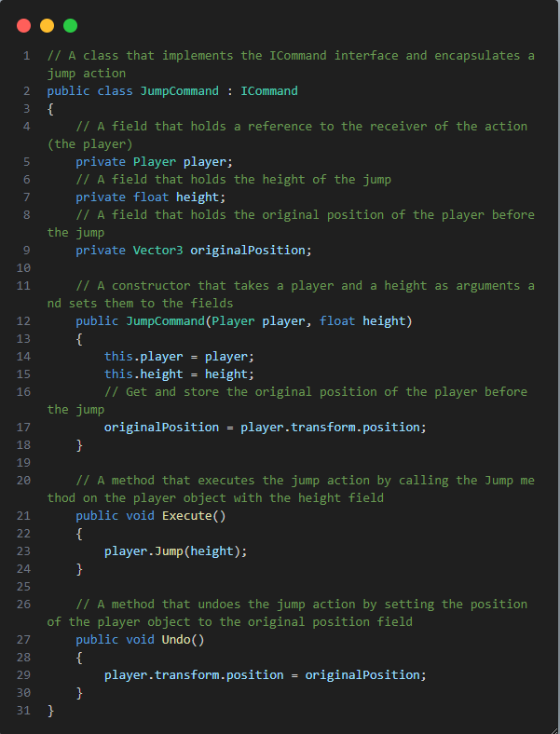
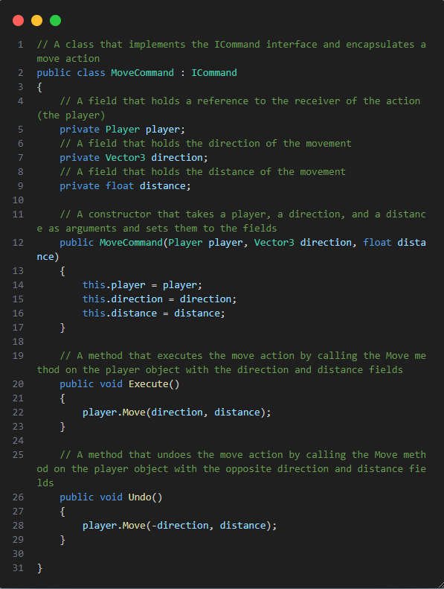

Slide 36
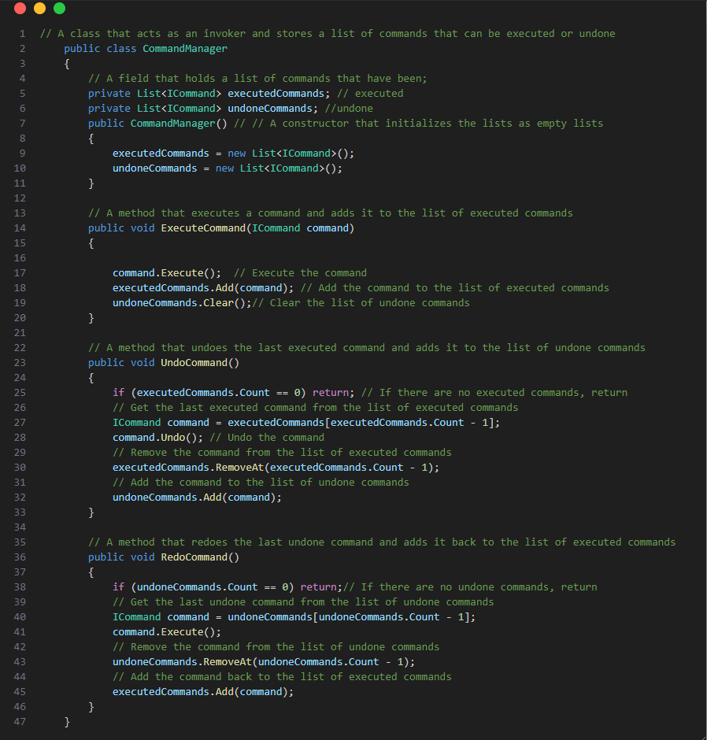

Slide 37
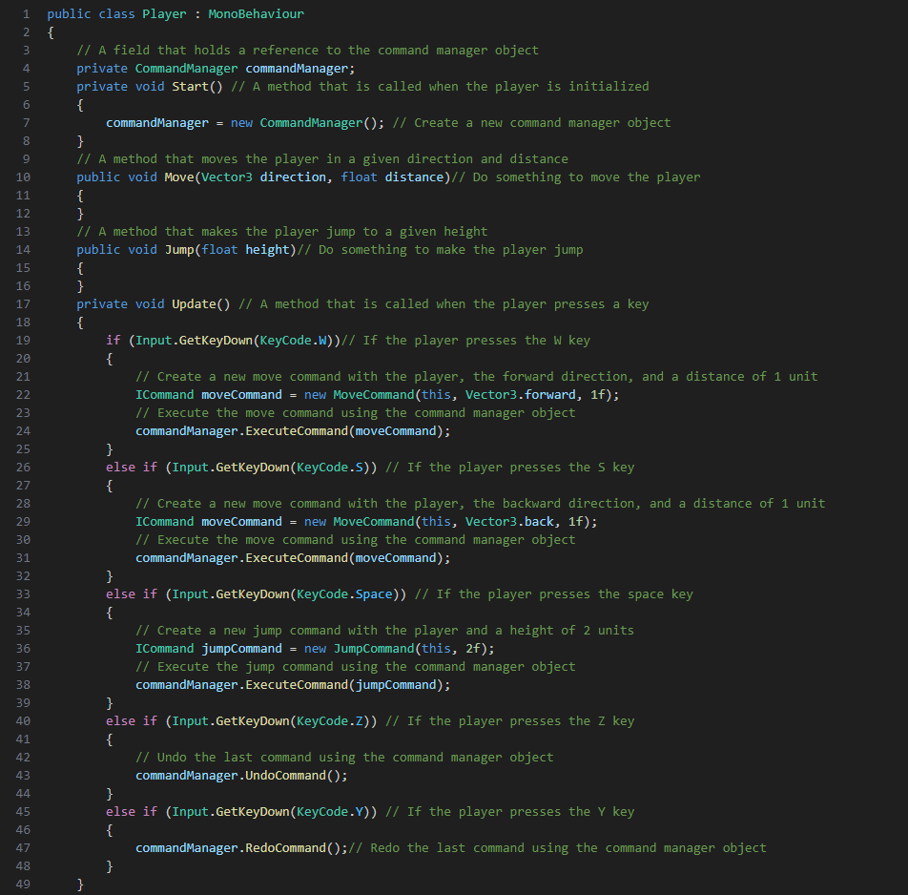
For example, in a game, you may have a Player class that can perform different actions, such as moving, jumping, attacking, etc. You want to separate the logic of these actions from the input system that triggers them, and also allow the player to undo or redo their actions.

Slide 38
COMMAND pattern - Pros and Cons
Single Responsibility Principle. You can decouple classes that invoke operations from classes that perform these operations.
Open/Closed Principle. You can introduce new commands into the app without breaking existing client code.
You can implement undo/redo.
You can implement deferred execution of operations.
You can assemble a set of simple commands into a complex one.
The code may become more complicated since you’re introducing a whole new layer between senders and receivers.

Slide 39
state pattern
The state pattern is a behavioral design pattern that lets an object alter its behavior when its internal state changes. It appears as if the object changed its class. The state pattern is closely related to the concept of a finite-state machine, which is a mathematical model of computation that has a finite number of states and can switch between them based on some inputs.
The state pattern allows an object to change its behavior based on its internal state. It encapsulates the state-dependent logic in separate classes. This pattern is useful when you need to implement complex state machines or finite state machines for game characters or systems.
Using the state pattern can solve some problems, such as coupling an object to its behavior, making it hard to add new states or change existing ones, and using conditional statements to alter the behavior based on the current state.

Slide 40
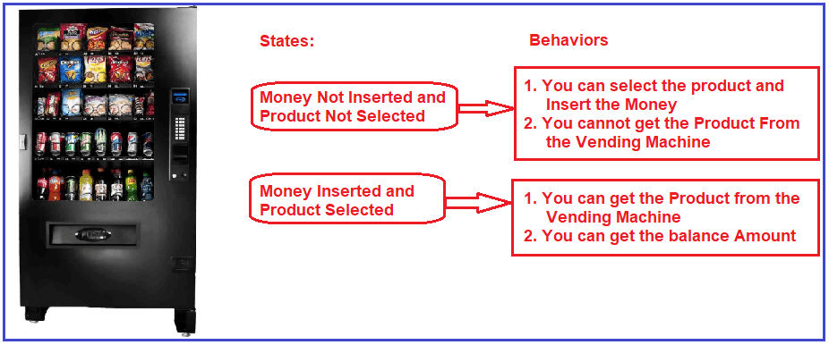
state pattern – Real world examples
A vending machine that changes its behavior based on the user’s input and the availability of products and change. For example, if the user selects a product that is out of stock, the machine displays a message and returns to the initial state. If the user inserts more money than the product’s price, the machine dispenses the product and returns the change.

Slide 41
state pattern
The state pattern involves three components: the context, the state and the concrete states.
The context is an object that has a reference to a state object that represents its current state. The context delegates all state-related behavior to the state object.
The state is an interface that defines the common methods for all concrete states.
The concrete states are classes that implement the state interface and define the specific behavior for each state.

Slide 42
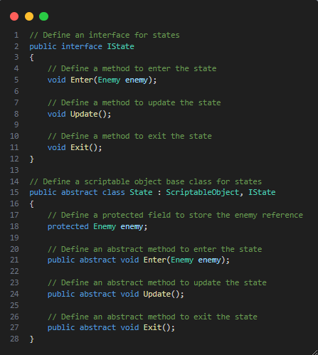
state pattern
The state pattern allows you to change the behavior of an object based on its internal state. You can use a state pattern to implement finite state machines for your game characters or systems, such as AI, animations, menus, or gameplay modes.
One way to implement the state pattern in Unity is to use scriptable objects. Scriptable objects are data containers that can hold information and logic independently of game objects. You can create scriptable objects for each state and define an interface for the common methods that each state should have, such as Enter, Update, and Exit.

Slide 43
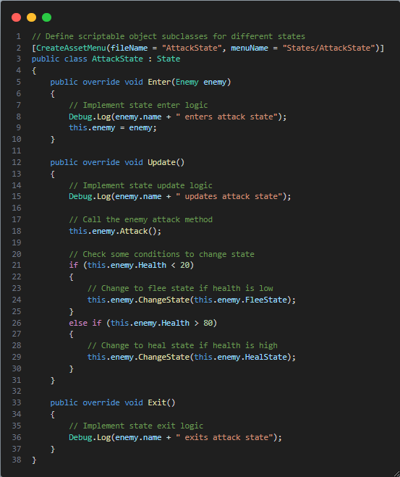
state pattern
Scriptable objects are a type of class that can be used to create and store data as assets in your project, independent of game objects or scenes1. They are useful for organizing and managing your game data, as well as sharing information across multiple objects or scripts.
To use a scriptable object, you need to create a script that inherits from the ScriptableObject class and define the fields and methods that you want to store and use in your data asset. You can also use the CreateAssetMenu attribute to make it easy to create custom assets using your class. Then, you can assign the scriptable object asset to any public or serialized field of type ScriptableObject or its subclass in any monobehaviour script.

Slide 44
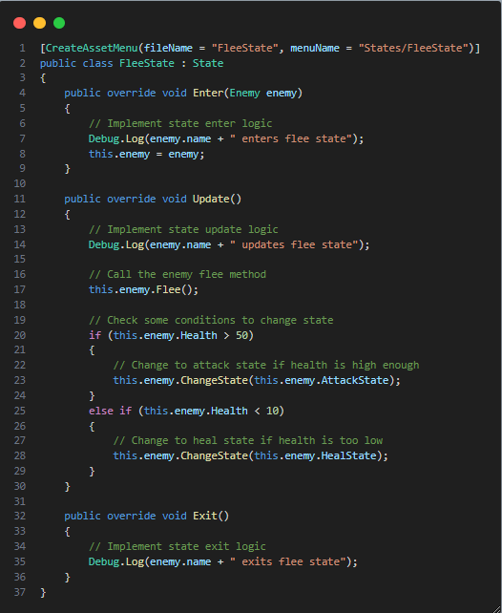
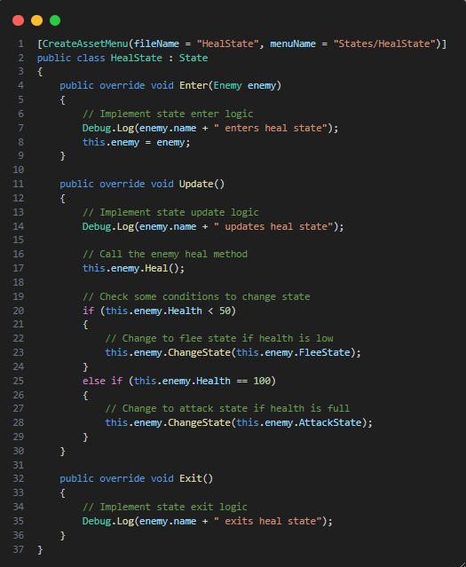

Slide 45
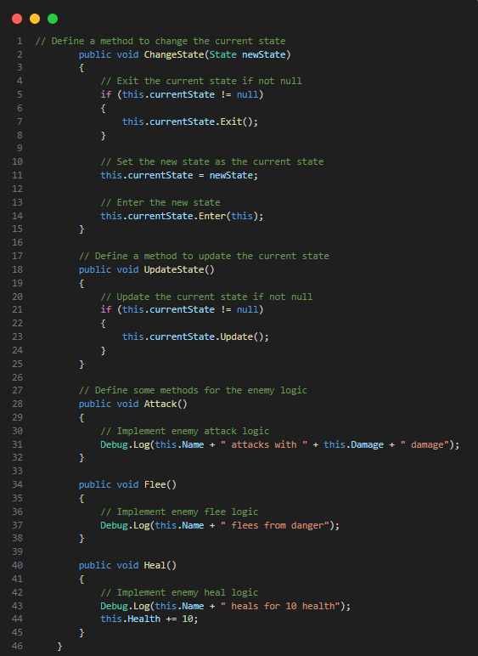
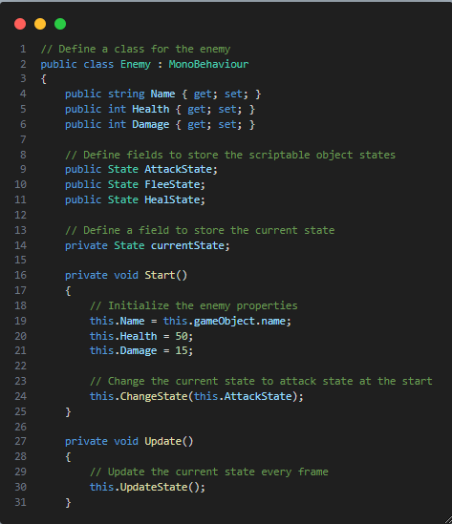
Part 2
Part 1

Slide 46
state pattern - Pros and Cons
Single Responsibility Principle. Organize the code related to particular states into separate classes.
Open/Closed Principle. Introduce new states without changing existing state classes or the context.
Simplify the code of the context by eliminating bulky state machine conditionals.
Applying the pattern can be overkill if a state machine has only a few states or rarely changes.

Slide 47
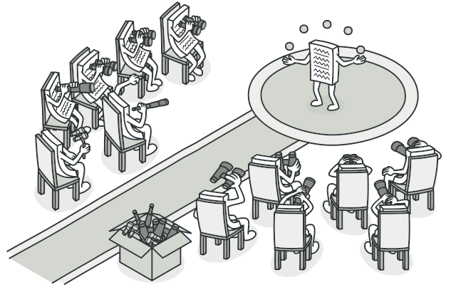
Observer pattern
The next one is the observer pattern. This pattern allows you to define a one-to-many dependency between objects so that when one object changes state, all its dependents are notified and updated automatically.
Observer is a behavioral design pattern that lets you define a subscription mechanism to notify multiple objects about any events that happen to the object they’re observing.

Slide 48

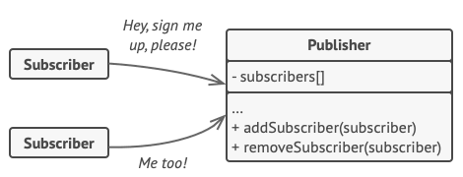
OBSERVER pattern – Real world examples
If you subscribe to a newspaper or magazine, you no longer need to go to the store to check if the next issue is available. Instead, the publisher sends new issues directly to your mailbox right after publication or even in advance.
The publisher maintains a list of subscribers and knows which magazines they’re interested in. Subscribers can leave the list at any time when they wish to stop the publisher sending new magazine issues to them.

Slide 49
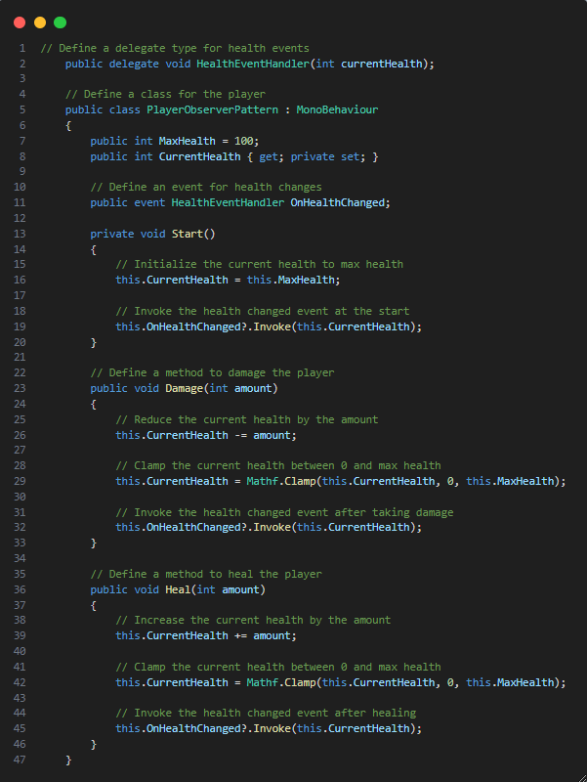
OBSERVER pattern
You can use an observer pattern to implement event-driven systems in your game, such as achievements, notifications, score updates, or health bars.
One way to implement the observer pattern in Unity is to use delegates and events. Delegates are types that represent references to methods with a specific parameter list and return type. Events are special types of delegates that can be invoked by the class that declares them but can be subscribed to by other classes .

Slide 50
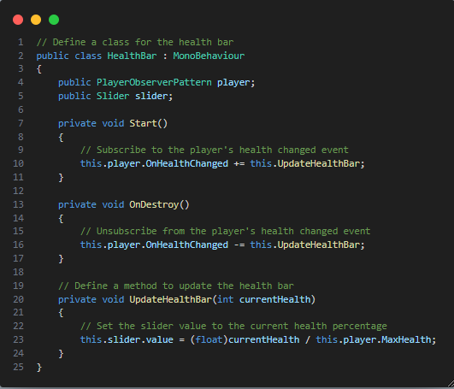
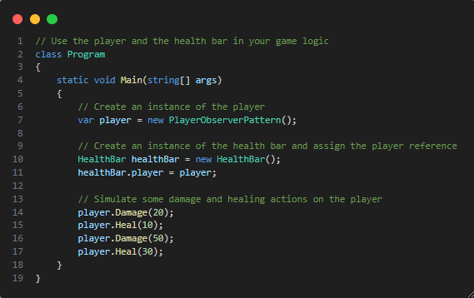

Slide 51
OBSERVER pattern - Pros and Cons
Open/Closed Principle. You can introduce new subscriber classes without having to change the publisher’s code (and vice versa if there’s a publisher interface).
You can establish relations between objects at runtime.
Subscribers are notified in random order.

Slide 52

THANKS!
HUAWEI – GAME DTSE

